Slide 1
Spread Spectrum

Slide 2
In a digital communication system the primary resources are Bandwidth and Power.
The study of digital communication system deals with efficient utilization of these two resources, but there are situations where it is necessary to sacrifice their efficient utilization in order to meet certain other design objectives.

Slide 3
Multiplexing combines signals from several sources to achieve bandwidth efficiency; the available bandwidth of a link is divided between the sources.
In spread spectrum we also combine signals from different sources to fit into a larger bandwidth, and the goals are somewhat different.
Spread spectrum is designed to be used in wireless applications. In these types of applications, we have some concerns that outweigh bandwidth efficiency.
In wireless applications, all stations use air (or a vacuum) as the medium for communication. Stations must be able to share this medium without interception by an eavesdropper and without being subject to jamming from a malicious intruder

Slide 4
A spread spectrum communications system is one that is built upon the principle of transmitting information signals over a much wider bandwidth than is strictly necessary for transferring the information.
By transmitting over a larger bandwidth, robustness against external narrowband interference is increased, since the wider the bandwidth of any transmitted signal the lower will be the relative influence of interference over a small part of the bandwidth.
Although from a single-link point of view, spread spectrum transmission may seem like very inefficient use of spectrum, this is not the case on a system level as spread spectrum techniques allow for simultaneous multiplexing of multiple transmissions in the same bandwidth.

Slide 5
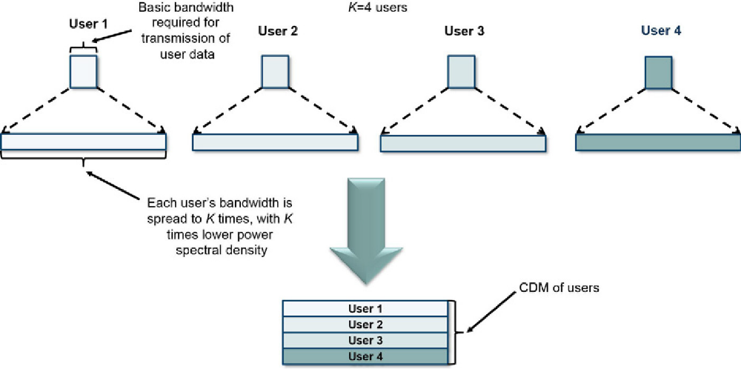
The principle of spread spectrum based user multiplexing.

Slide 6
Spread spectrum achieves its goals through two principles:
1. The bandwidth allocated to each station needs to be, by far, larger than what is needed. This allows redundancy. If the required bandwidth for each station is B, spread spectrum expands it to Bss' such that Bss » B. The expanded bandwidth allows the source to wrap its message in a protective envelope for a more secure transmission.
2. The expanding of the original bandwidth B to the bandwidth Bss must be done by a process that is independent of the original signal. In other words, the spreading process occurs after the signal is created by the source.
After the signal is created by the source, the spreading process uses a spreading code and spreads the bandwidth.
The figure shows the original bandwidth B and the spreaded bandwidth Bss. The spreading code is a series of numbers that look random, but are actually a pattern.

Slide 7
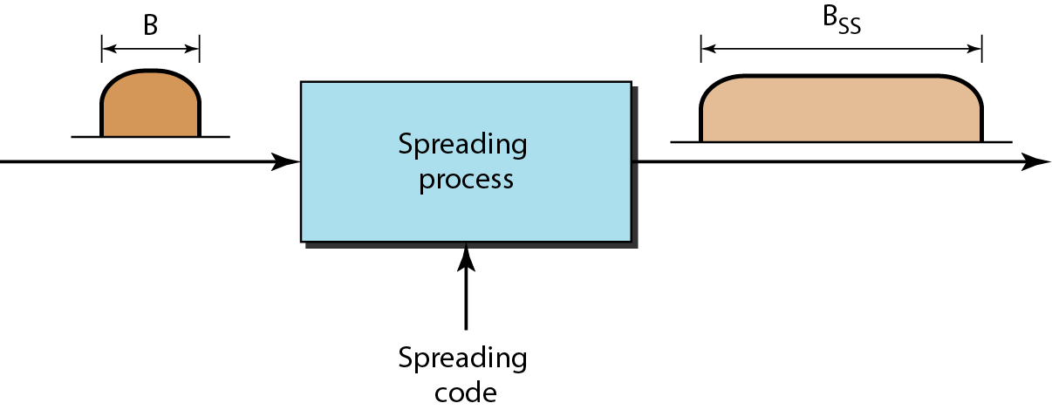

Slide 8
Spread Spectrum
A signal that occupies a bandwidth of B, is spread out to occupy a bandwidth of B_{ss}
All signals are spread to occupy the same bandwidth B_{ss}
Signals are spread with different codes so that they can be separated at the receivers.
Signals can be spread in the frequency domain or in the time domain.

Slide 9
Spread Spectrum
Input is fed into a channel encoder
  Produces analog signal with narrow bandwidth
Signal is further modulated using sequence of digits
  Spreading code or spreading sequence
  Generated by pseudonoise, or pseudo-random number generator
Effect of modulation is to increase bandwidth of signal to be transmitted
On receiving end, digit sequence is used to demodulate the spread spectrum signal
Signal is fed into a channel decoder to recover data

Slide 10
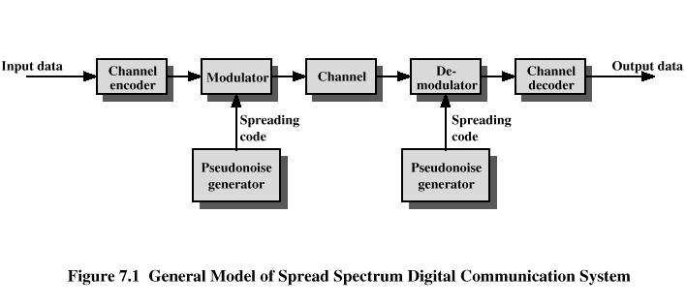
Spread Spectrum

Slide 11
In telecommunication and radio communication, spread-spectrum techniques are methods by which a signal (e.g., an electrical, electromagnetic, or acoustic signal) generated with a particular bandwidth is deliberately spread in the frequency domain, resulting in a signal with a wider bandwidth.
These techniques are used for a variety of reasons, including the establishment of secure communications, increasing resistance to natural interference, noise, and jamming, to prevent detection, to limit power flux density (e.g., in satellite downlinks), and to enable multiple-access communications.

Slide 12
Spread spectrum generally makes use of a sequential noise-like signal structure to spread the normally narrowband information signal over a relatively wideband (radio) band of frequencies.
The receiver correlates the received signals to retrieve the original information signal.
Originally there were two motivations: either to resist enemy efforts to jam the communications (anti-jam, or AJ), or to hide the fact that communication was even taking place, sometimes called low probability of intercept (LPI)

Slide 13
Spread Spectrum
What can be gained from apparent waste of spectrum?
  Immunity from various kinds of noise and multipath distortion
  Can be used for hiding and encrypting signals
  Several users can independently use the same higher bandwidth with very little interference

Slide 14
Types
Frequency-hopping spread spectrum (FHSS),
Direct-sequence spread spectrum (DSSS),
Time-hopping spread spectrum (THSS),
Chirp spread spectrum (CSS), and combinations of these techniques are forms of spread spectrum.
The first two of these techniques employ pseudorandom number sequences—created using pseudorandom number generators—to determine and control the spreading pattern of the signal across the allocated bandwidth.
Wireless standard IEEE 802.11 uses either FHSS or DSSS in its radio interface.

Slide 15
Frequency-hopping spread spectrum (FHSS) is a method of transmitting radio signals by rapidly changing the carrier frequency among many distinct frequencies occupying a large spectral band. The changes are controlled by a code known to both transmitter and receiver.
FHSS is used to avoid interference, to prevent eavesdropping, and to enable code-division multiple access (CDMA) communications.
The available frequency band is divided into smaller sub-bands. Signals rapidly change ("hop") their carrier frequencies among the center frequencies of these sub-bands in a predetermined order.
Interference at a specific frequency will only affect the signal during a short interval

Slide 16
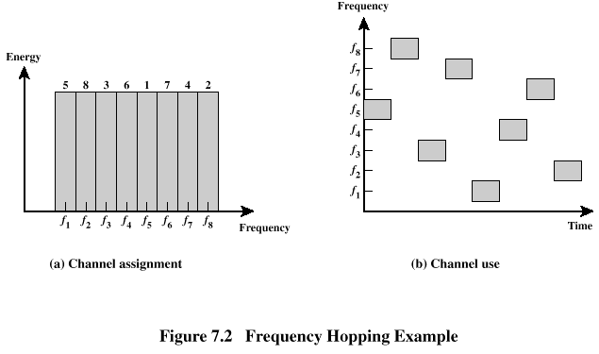
Frequency Hoping Spread Spectrum

Slide 17
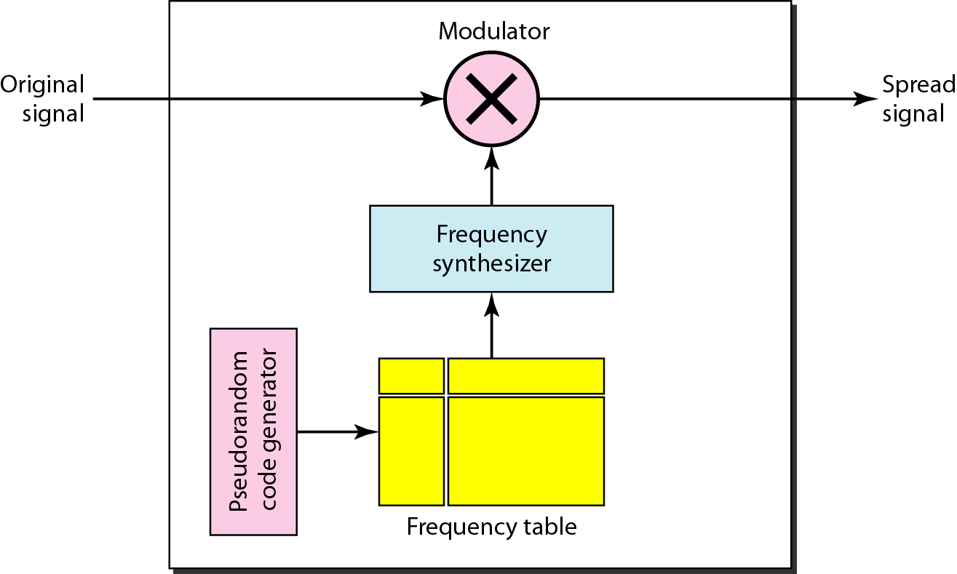
Frequency hopping spread spectrum (FHSS)

Slide 18
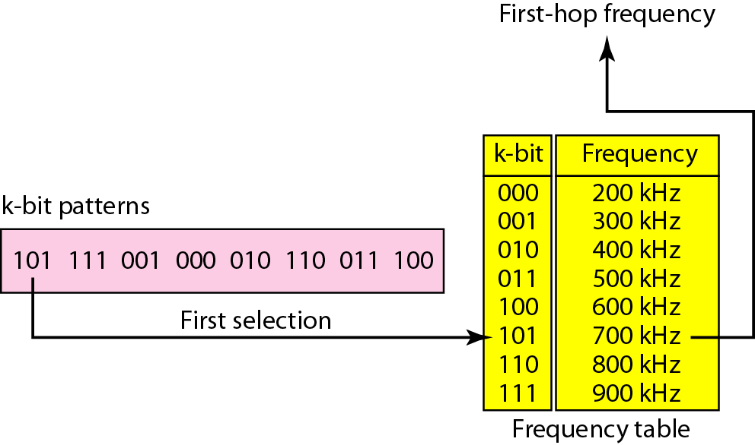
Frequency selection in FHSS

Slide 19
Direct-sequence spread spectrum (DSSS) is a spread spectrum modulation technique primarily used to reduce overall signal interference.
The direct-sequence modulation makes the transmitted signal wider in bandwidth than the information bandwidth.
After the de-spreading or removal of the direct-sequence modulation in the receiver, the information bandwidth is restored, while the unintentional and intentional interference is substantially reduced

Slide 20
Direct Sequence Spread Spectrum (DSSS)
Each bit in original signal is represented by multiple bits in the transmitted signal
Spreading code spreads signal across a wider frequency band
  Spread is in direct proportion to number of bits used
One technique combines digital information stream with the spreading code bit stream using exclusive-OR

Slide 21
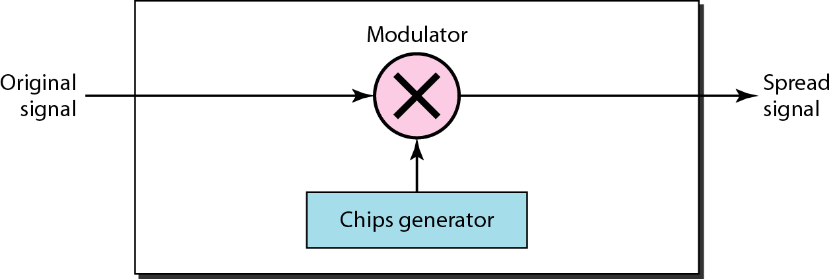
DSSS

Slide 22
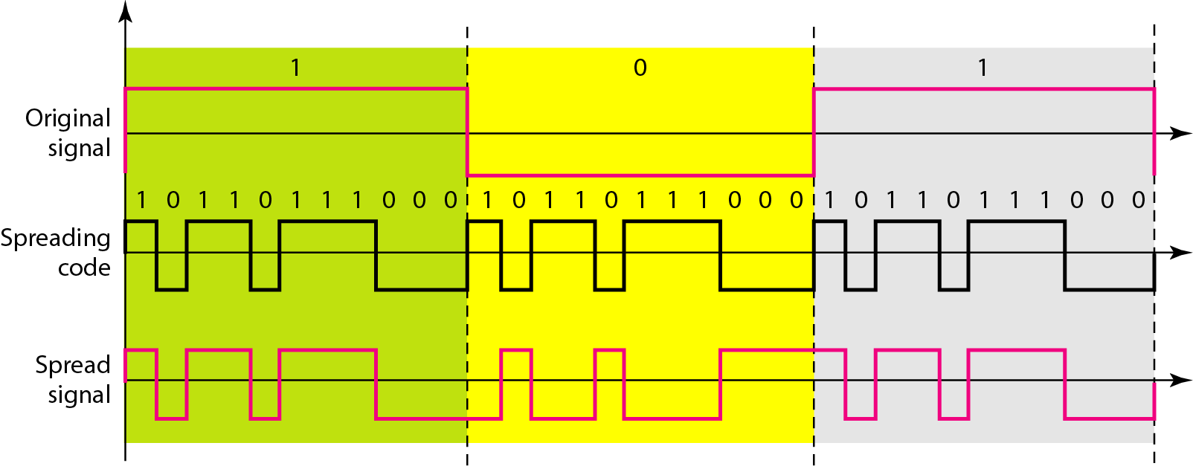
DSSS example

Slide 23
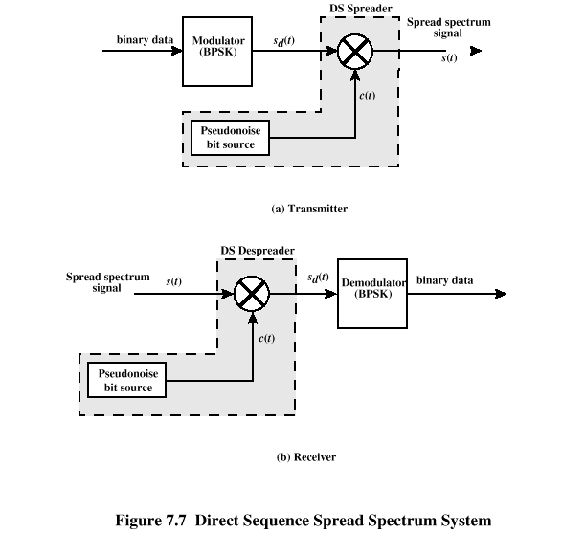

Slide 24
Time-hopping (TH) is a communications signal technique which can be used to achieve anti-jamming (AJ) or low probability of intercept (LPI).
It can also refer to pulse-position modulation, which in its simplest form employs 2^{k} discrete pulses (referring to the unique positions of the pulse within the transmission window) to transmit k bit(s) per pulse.

Slide 25
Chirp spread spectrum (CSS) is a spread spectrum technique that uses wideband linear frequency modulated chirp pulses to encode information.
A chirp is a sinusoidal signal whose frequency increases or decreases over time (often with a polynomial expression for the relationship between time and frequency).

